Slide 1
Encode—decoder + transformer network
Mihai Surdeanu
NLP Reading Group, Spring 2019

Slide 2
Examples of sequence-to-sequence applications?
Can you think of at least 3?

Slide 3
Use case
We will use machine translation (MT) as a use case for these papers

Slide 4
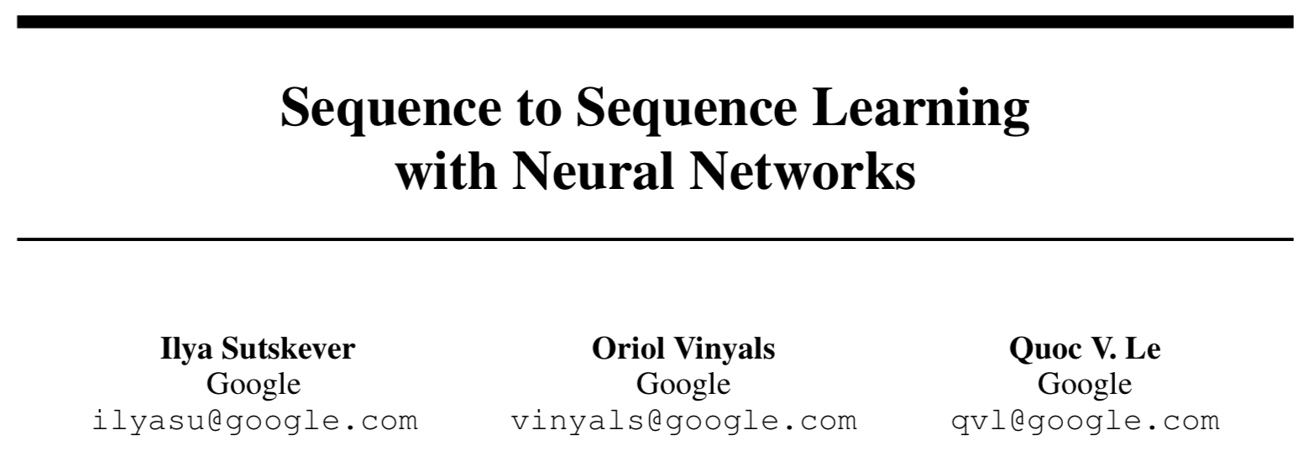
The original encoder-decoder paper

Slide 5
Contributions
Beyond standard NNs
“DNNs can only be applied to problems whose inputs and targets can be sensibly encoded with vectors of fixed dimensionality”
Really good performance for WM
“On the WMT’14 English to French translation task, we obtained a BLEU score of 34.81 by directly extracting translations from an ensemble of 5 deep LSTMs (with 380M parameters each) using a simple left-to-right beam-search decoder.”
Phrase-based SMT was 33.30 BLEU at the time
Used in reranking mode for a SMT, it improved its BLEU score by 3.2 points
Does well on long sentences (see reading group paper on LSTM context)

Slide 6
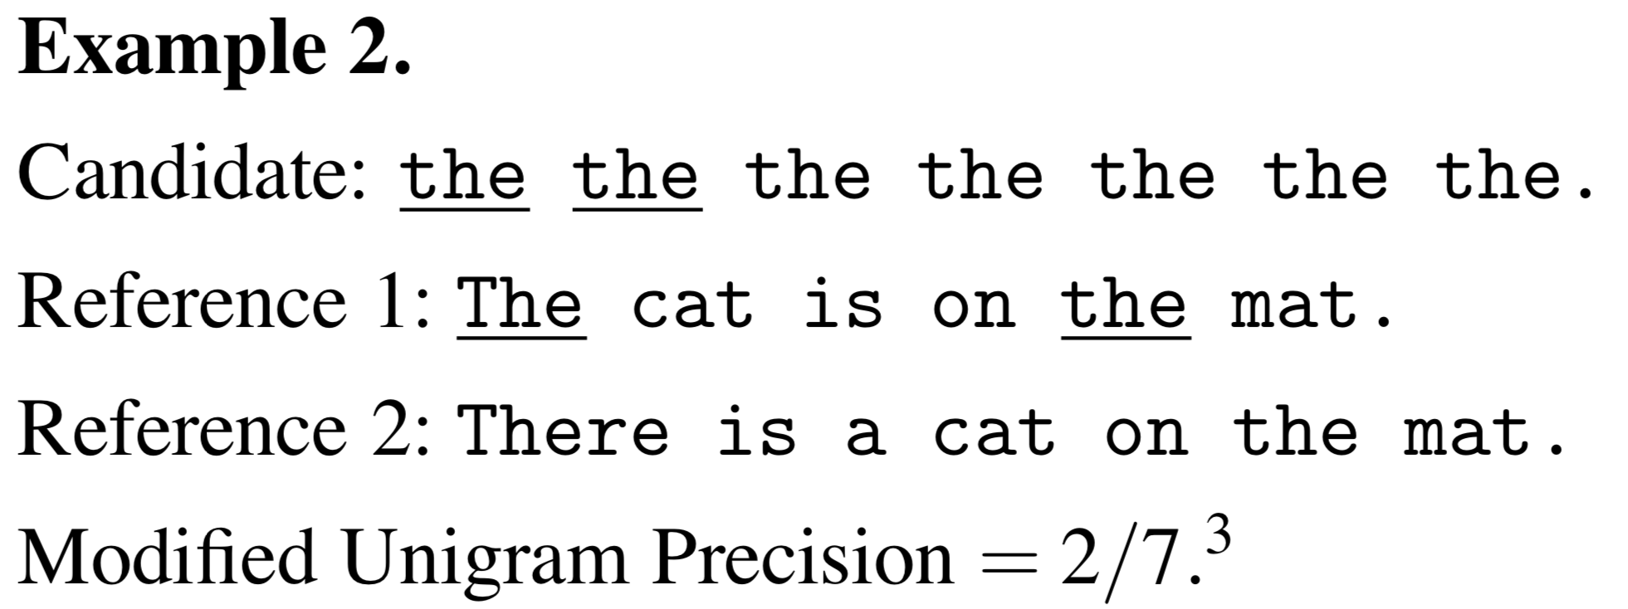
BLEU = modified n-gram precision
n-gram counts clipped by their maximum reference count

Slide 7
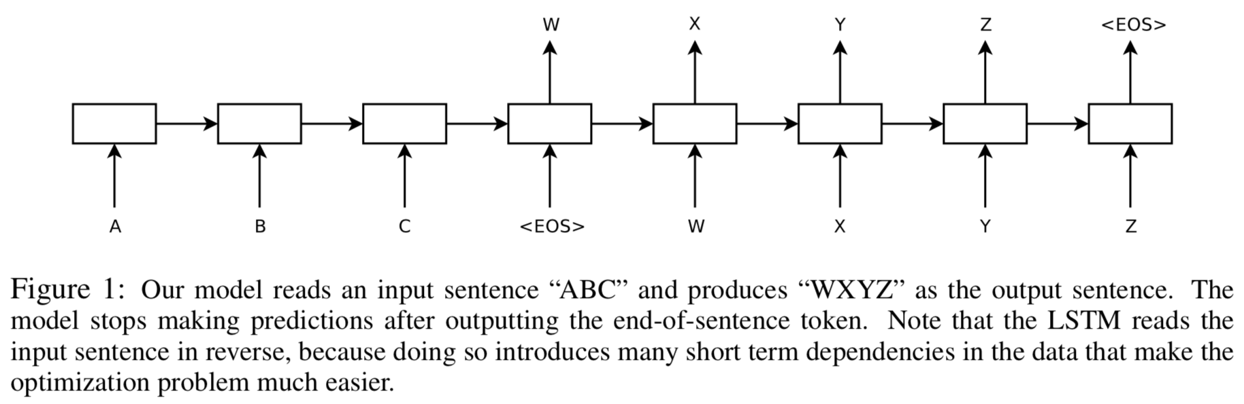
Intuition
The ”interlingua” representation, obtained by jointly training the two LSTMs
LSTM 2: decodes the output sentence as a language model
LSTM 1: encodes the input sentence

Slide 8
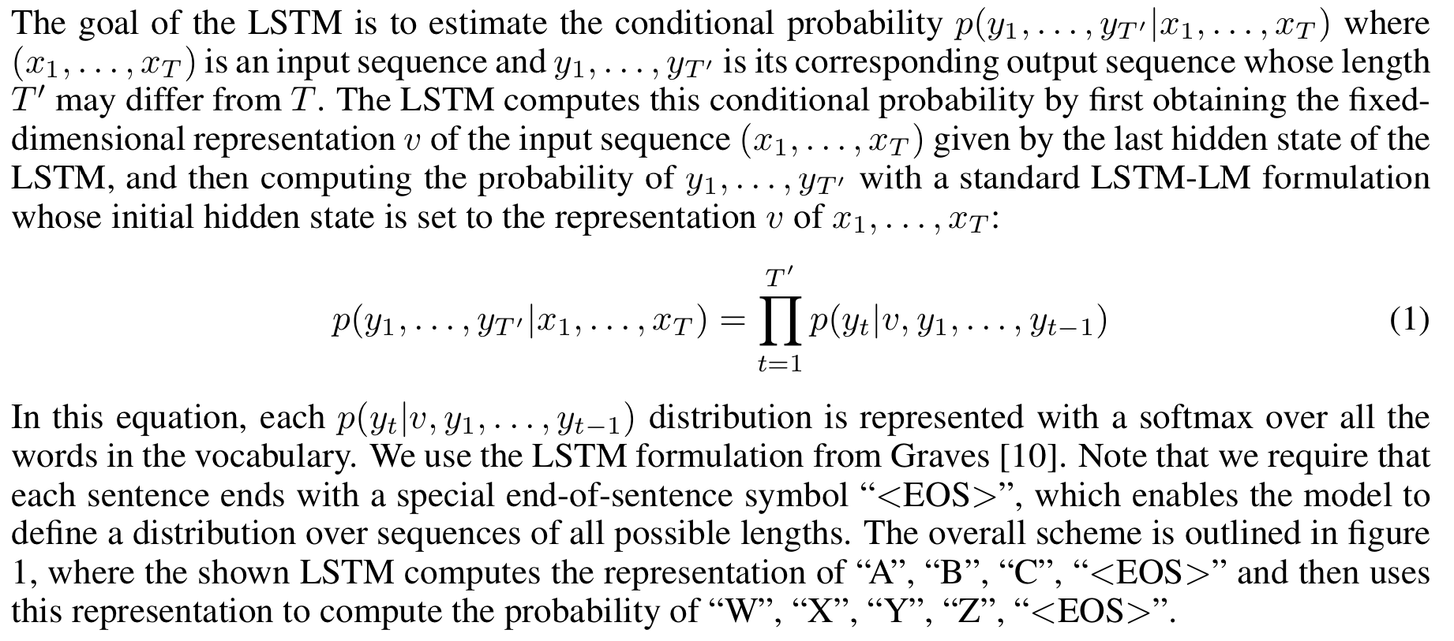
Formalization

Slide 9
Details
Two LSTMs used, one for the input sequence and one for the output one
Why is this useful? (In DyNet it is trivial to implement this with a single LSTM…)
Deep LSTMs with 4 layers
Probably learns an “interlingua”, but we don’t know what it is…
Reversed the input sequence
Map from c,b,a to α,β,γ
This way, a is in close proximity to α, b is fairly close to β, and so on
Notes:
Hint: multi-task learning

Slide 10
Two types of experiments
Direct translation
Reranking the n-best lists of a SMT baseline

Slide 11
Dataset details
English to French
12M aligned sentences
304M English words
348M French words
1000-best lists from a SOA SMT system
Fixed vocabularies based on frequency
160K for English
80K for French (!!)
Out-of-vocabulary words replaced with UNK (!)
Notes:
Why smaller French vocabulary
UNK could be better addressed with character LMs now

Slide 12
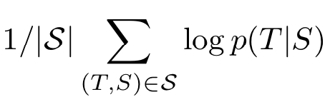
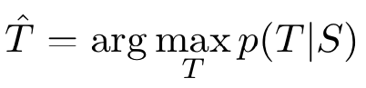
Decoding details
Cross-entropy objective function:
Inference:
Simple beam search decoder (!)
Maintains the top B hypotheses at each time step
At each timestep they extend each partial hypothesis in the beam with every possible word in the vocabulary (but keep the top B)
Decent performance with B = 1, good with B = 2
Notes:
Viterbi might be better?

Slide 13
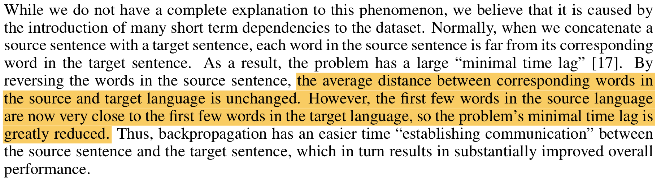
Intuition for input sentence reversal

Slide 14
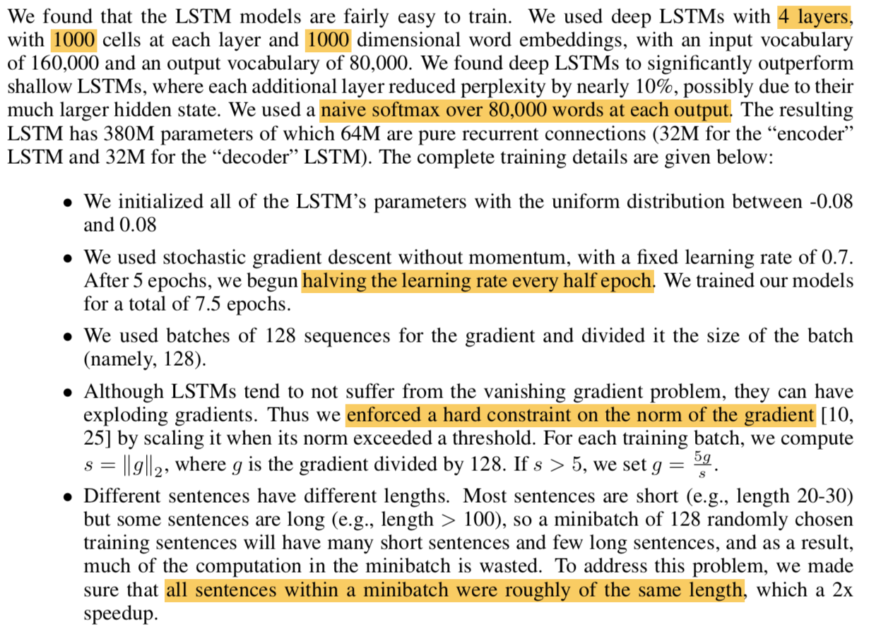
Training details

Slide 15
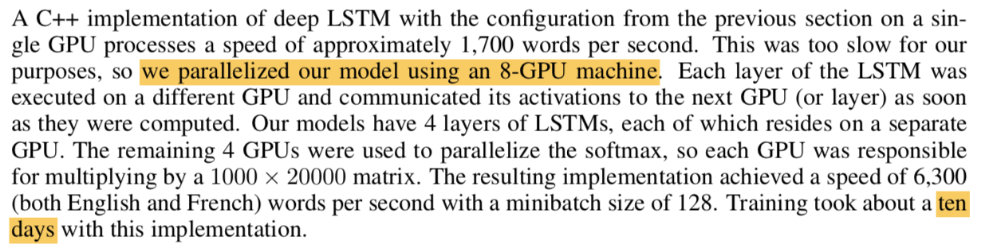
Parallelization

Slide 16
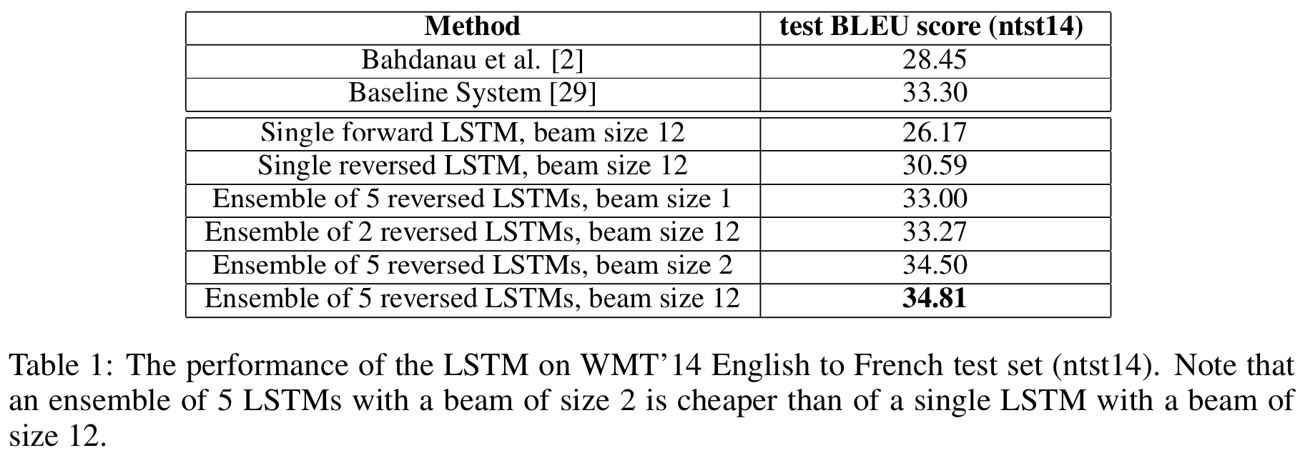
Results: direct translation

Slide 17
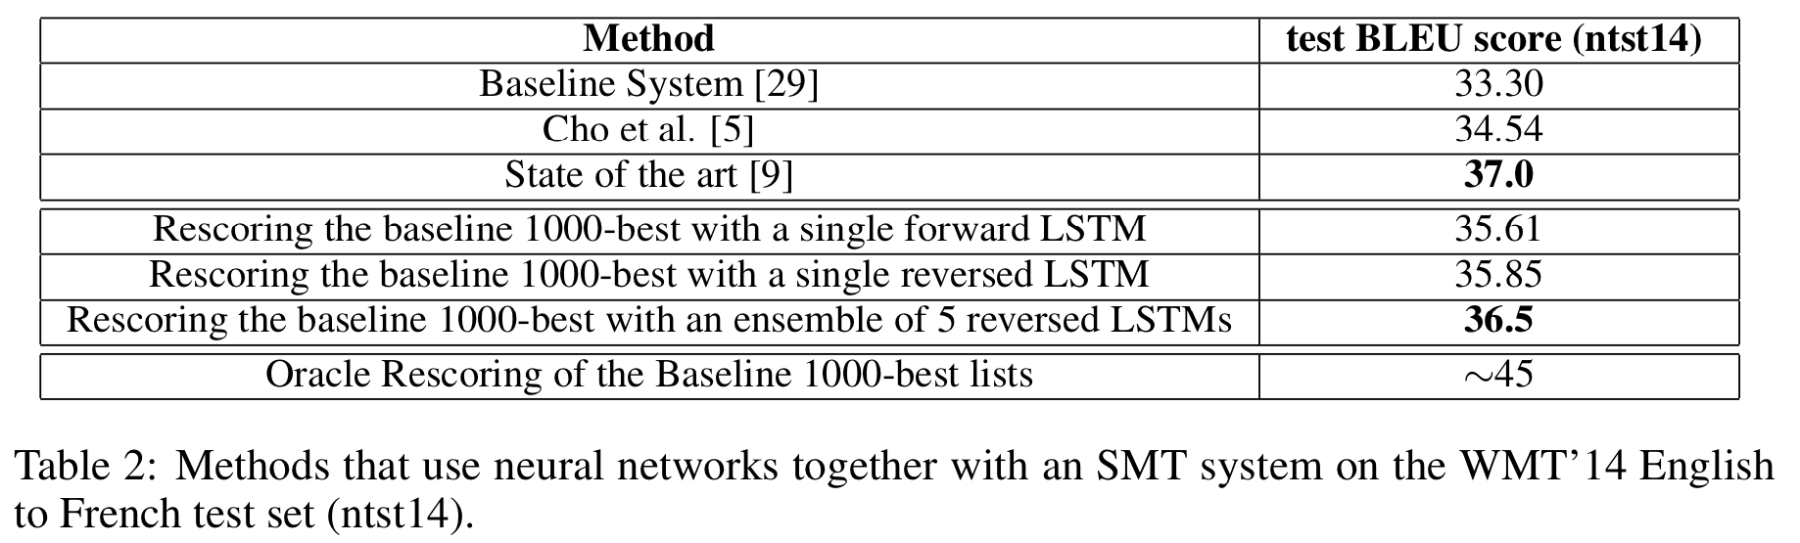
Results: reranking

Slide 18
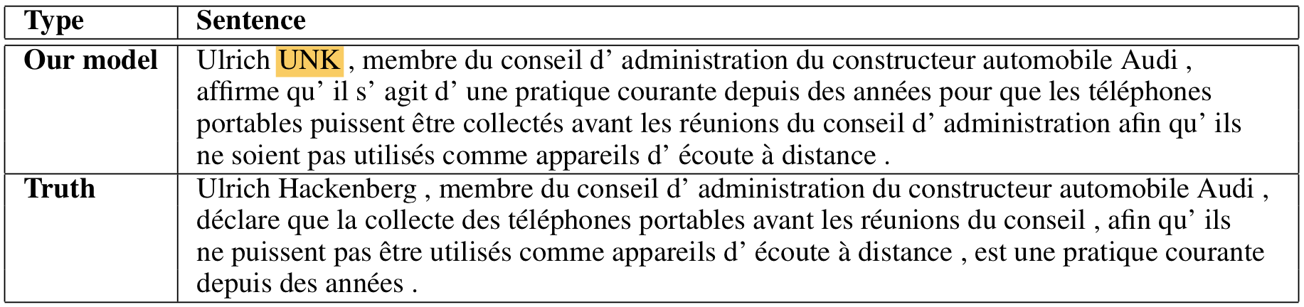
Examples of long sentences generated

Slide 19
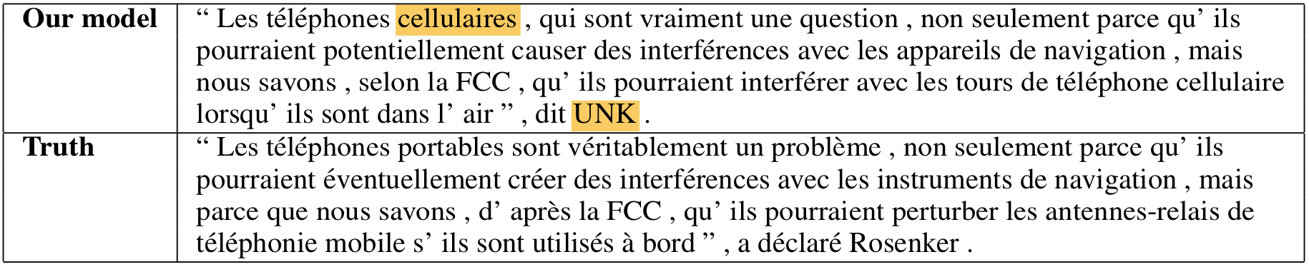
Examples of long sentences generated

Slide 20
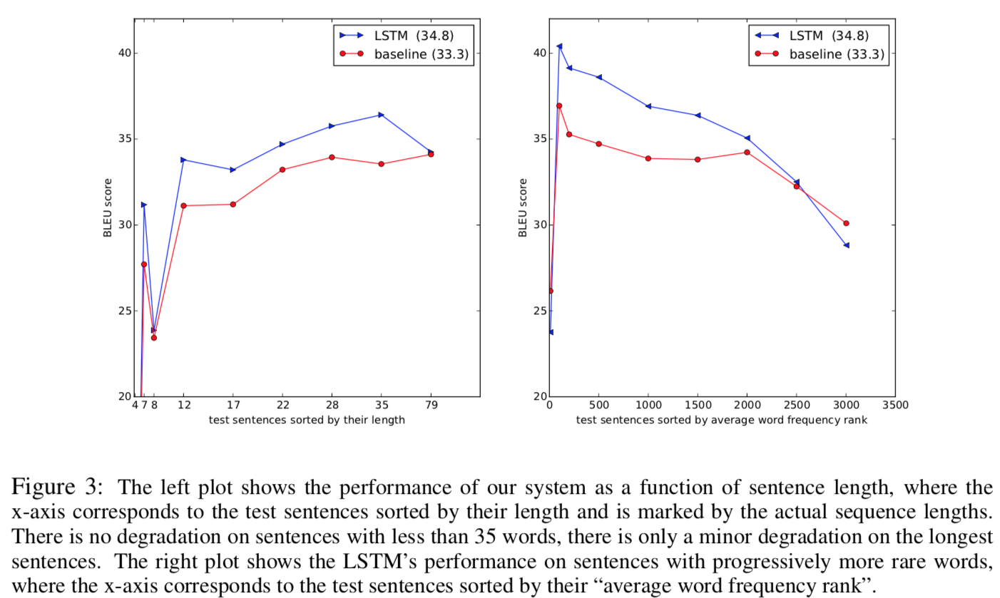
Analysis

Slide 21


Slide 22
Some slides taken from these blogs
https://jalammar.github.io/illustrated-transformer/
https://mchromiak.github.io/articles/2017/Sep/12/Transformer-Attention-is-all-you-need/

Slide 23
Contribution
The first successful (but beastly) alternative to the ubiquity of the bi-LSTM
(How much can this be simplified?)

Slide 24
Contribution
In this work we propose the Transformer, a model architecture eschewing recurrence and instead relying entirely on an attention mechanism to draw global dependencies between input and output
SOA performance, easy to parallelize: New state of the art in translation quality after being trained for as little as twelve hours on eight P100 GPUs.

Slide 25


Slide 26
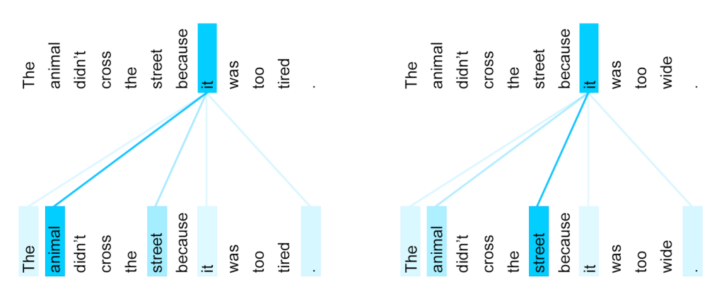
Intuition: the encoding of each word depends on its surrounding words

Slide 27
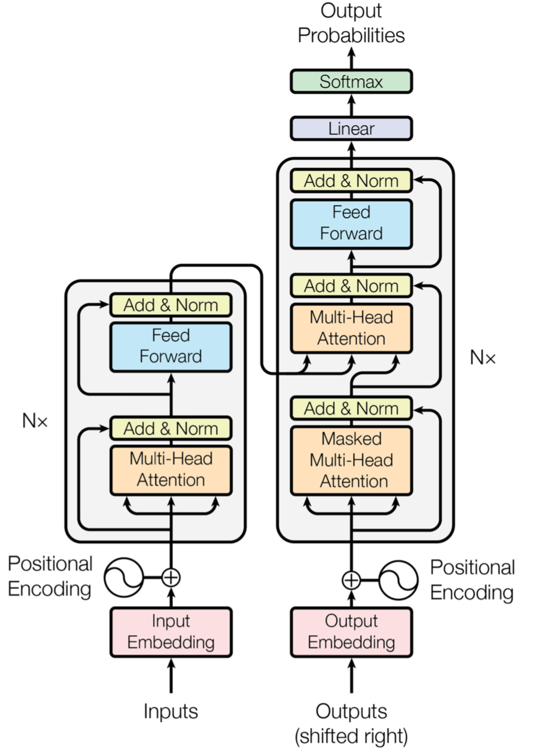

Slide 28
Self attention for input words

Slide 29
Self attention for output words!

Slide 30
Regular attention from encoder to decoder

Slide 31
Position embeddings

Slide 32
Stacked encoders and decoders
N = 6

Slide 33
Attention

Slide 34


Slide 35
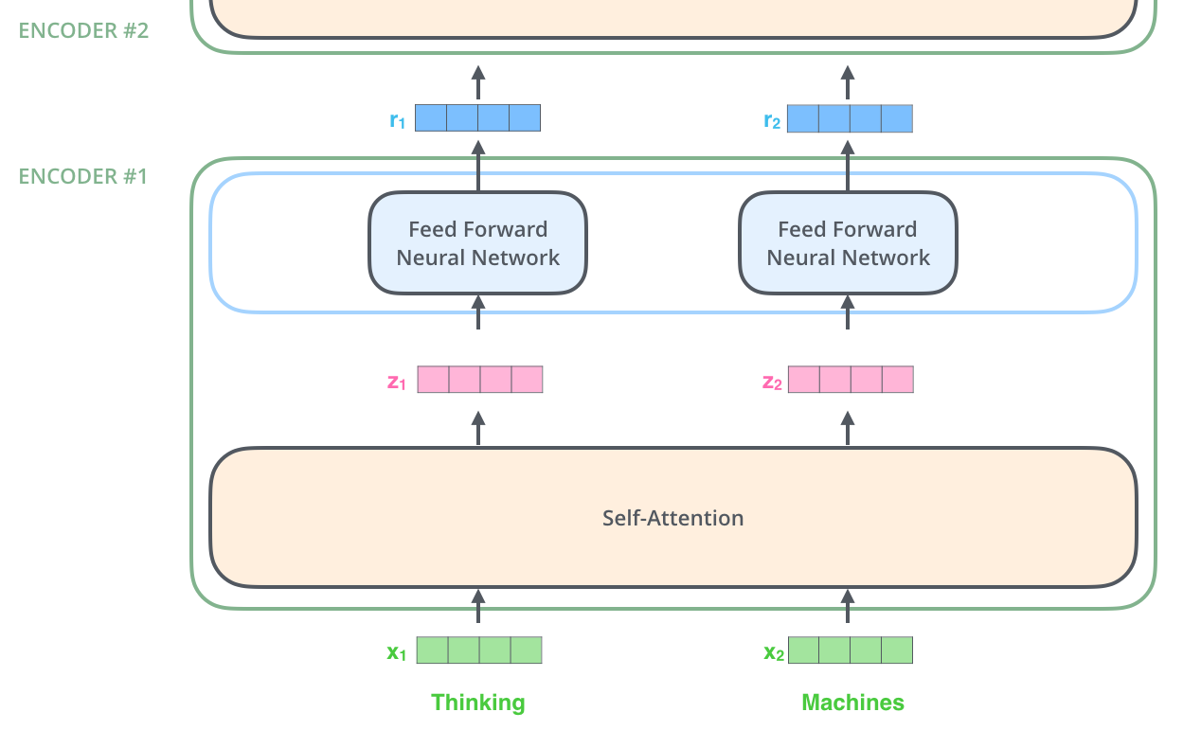

Slide 36

Attention is more interpretable than an LSTM!

Slide 37


Slide 38
Project the input embeddings into a new space (needed for multi-head attention)

Slide 39
Used for the weighted average needed for the output vector

Slide 40
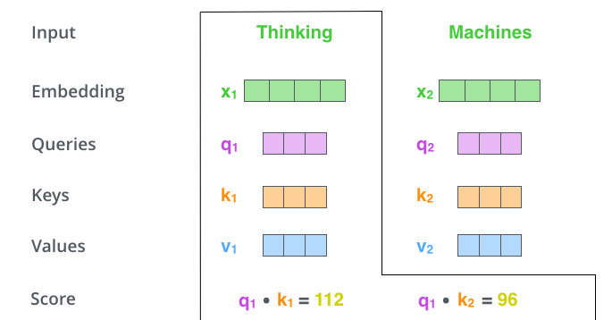
Computing the output vector for “Thinking”
How important each word in the sentence is for “Thinking”

Slide 41
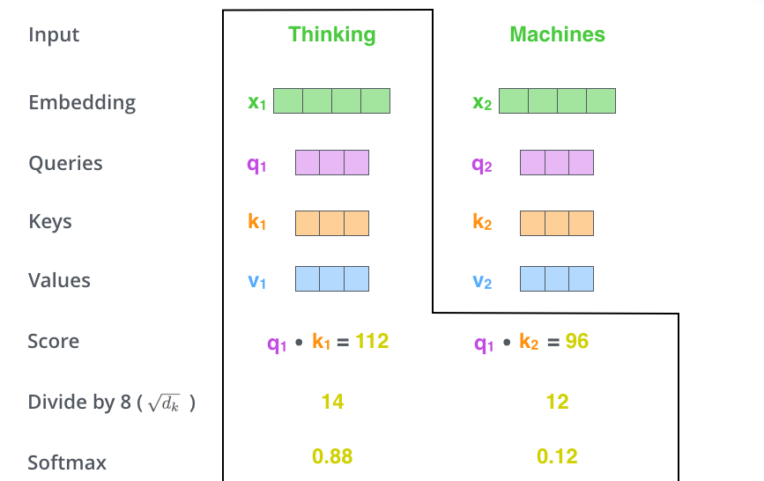

Slide 42
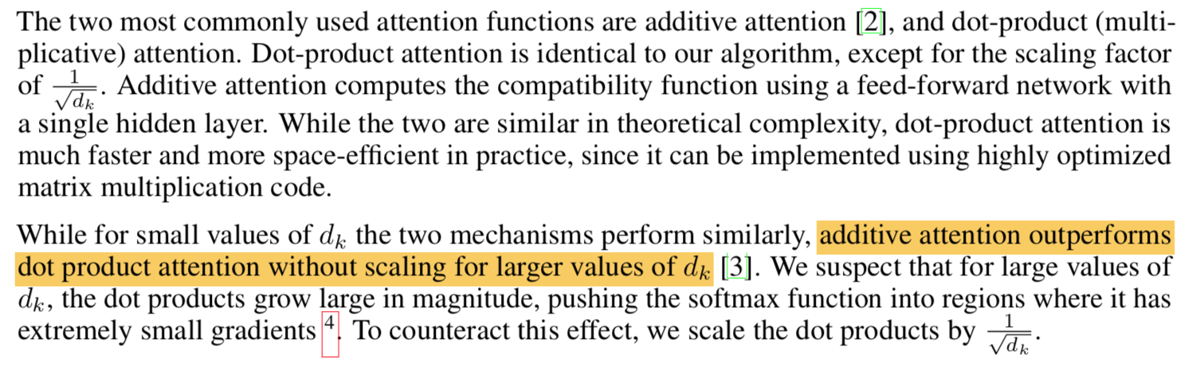

Slide 43


Slide 44
Multi-head attention
Multi-head attention allows the model to jointly attend to information from different representation subspaces at different positions. With a single attention head (what we saw before), averaging inhibits this.

Slide 45
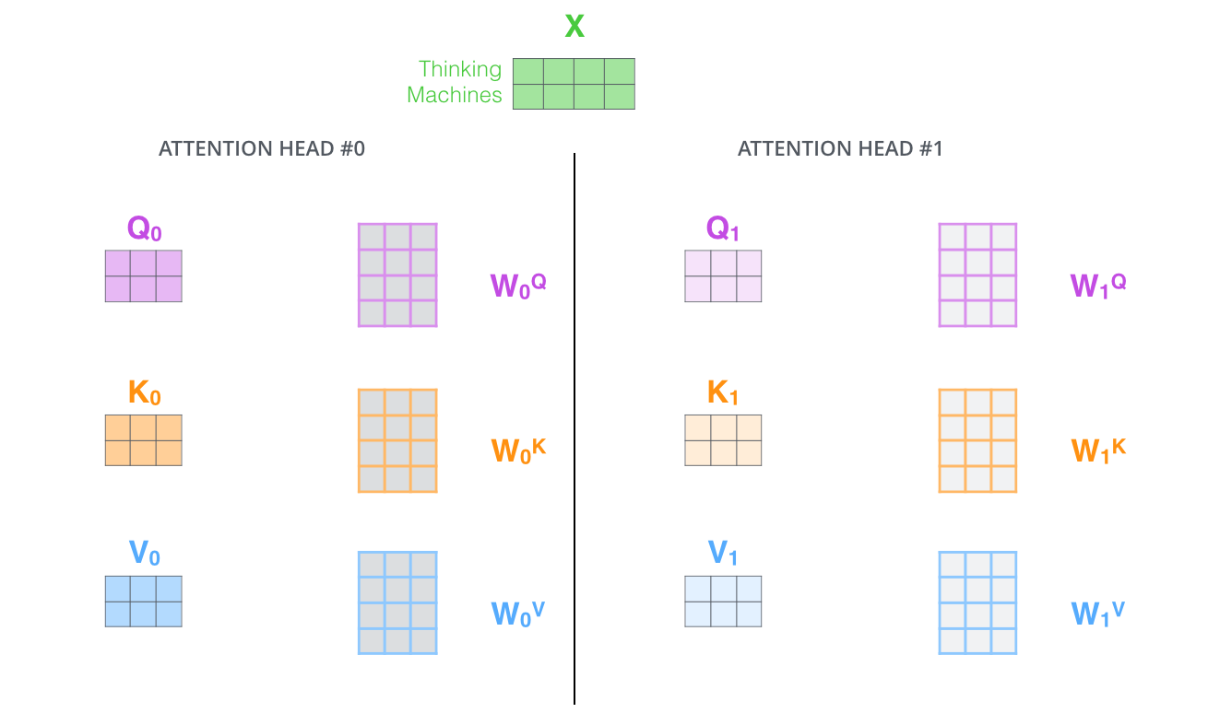

Slide 46
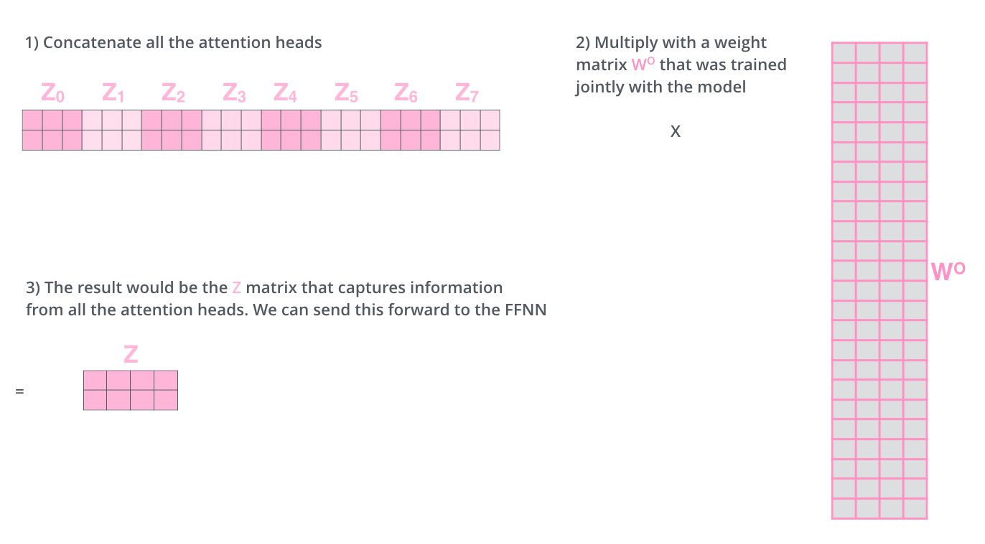

Slide 47

Summary: all attention matrices

Slide 48
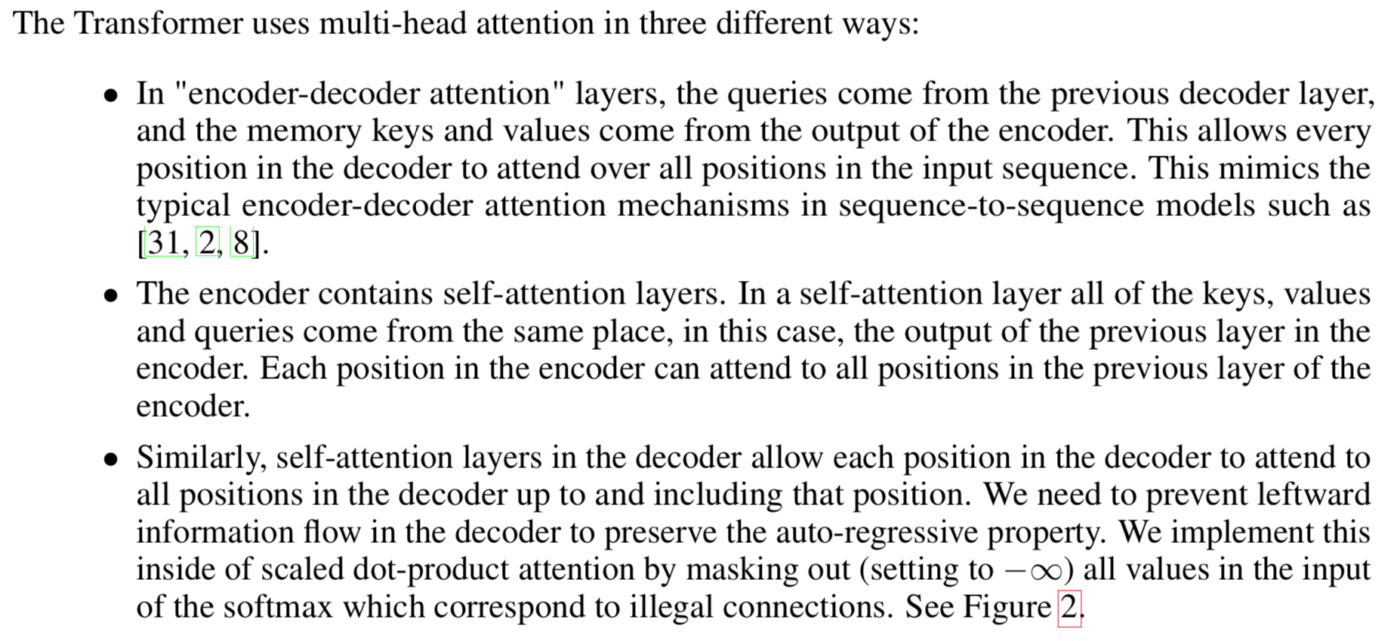
Applications of attention

Slide 49
Layer Normalization

Slide 50
Layer normalization

Slide 51
Layer normalization
Training state-of-the-art, deep neural networks is computationally expensive. One way to reduce the training time is to normalize the activities of the neurons.
A recently introduced technique called batch normalization uses the distribution of the summed input to a neuron over a mini-batch of training cases to compute a mean and variance which are then used to normalize the summed input to that neuron on each training case.
In this paper, we transpose batch normalization into layer normalization by computing the mean and variance used for normalization from all of the summed inputs to the neurons in a layer on a single training case.
Paper: https://arxiv.org/abs/1607.06450

Slide 52


Slide 53
Position Embeddings

Slide 54
Position embeddings

Slide 55
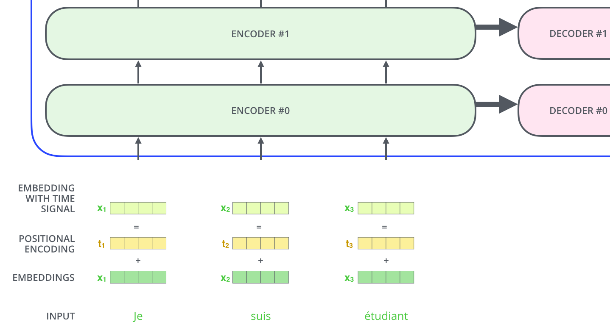

Slide 56
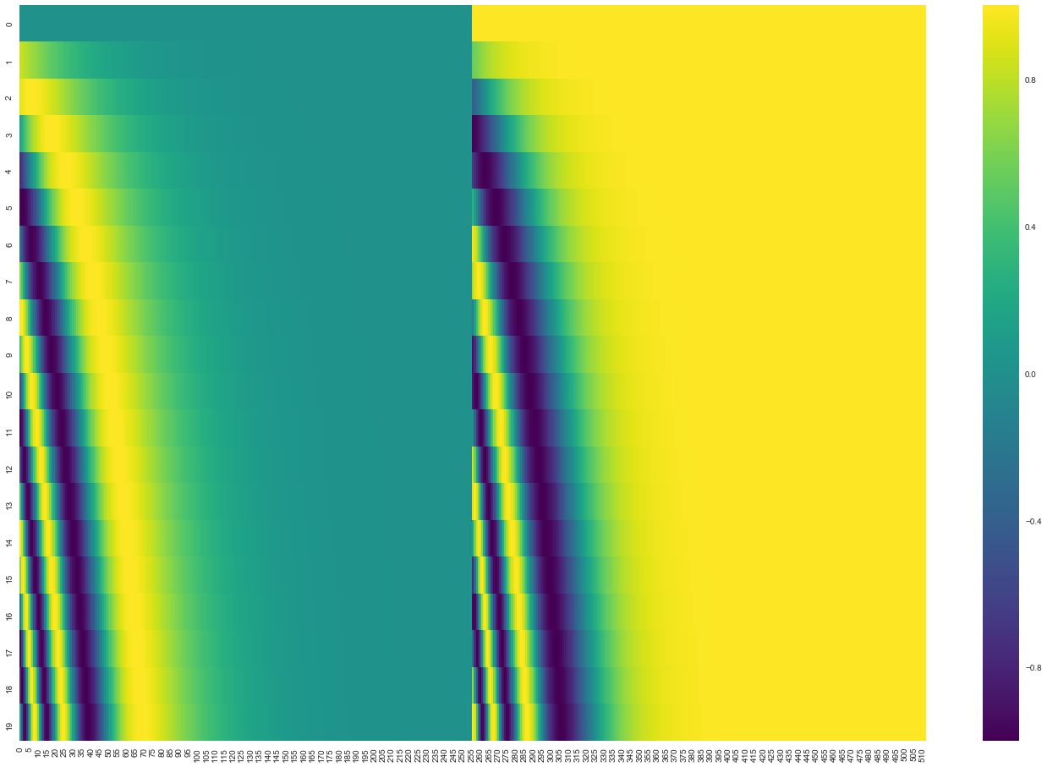
A real example of positional encoding for 20 words (rows) with an embedding size of 512 (columns). You can see that it appears split in half down the center. That's because the values of the left half are generated by one function (which uses sine), and the right half is generated by another function (which uses cosine). They're then concatenated to form each of the positional encoding vectors.

Slide 57
Advantages
No learning
They extrapolate to sequence lengths longer than the ones encountered during training
Nearly identical results to learned position embeddings (the classic approach)

Slide 58
Stacked Architecture

Slide 59


Slide 60
Objective function

Slide 61
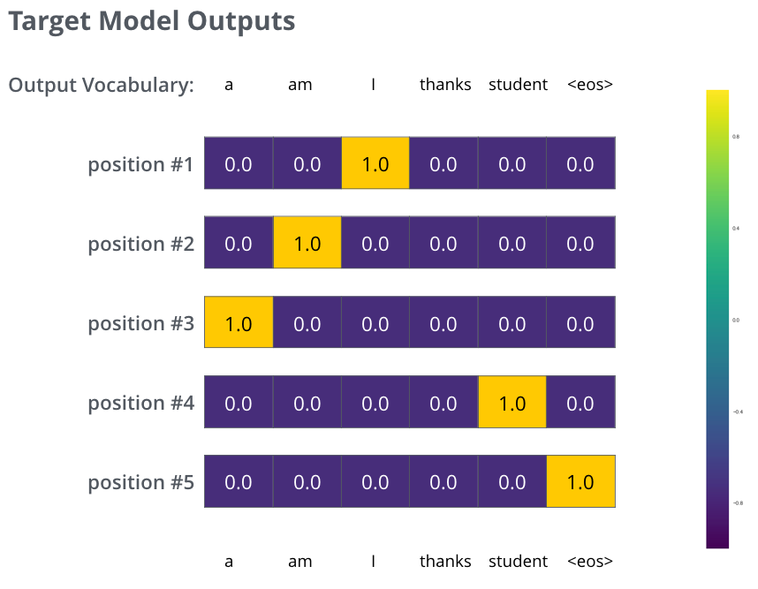

Slide 62
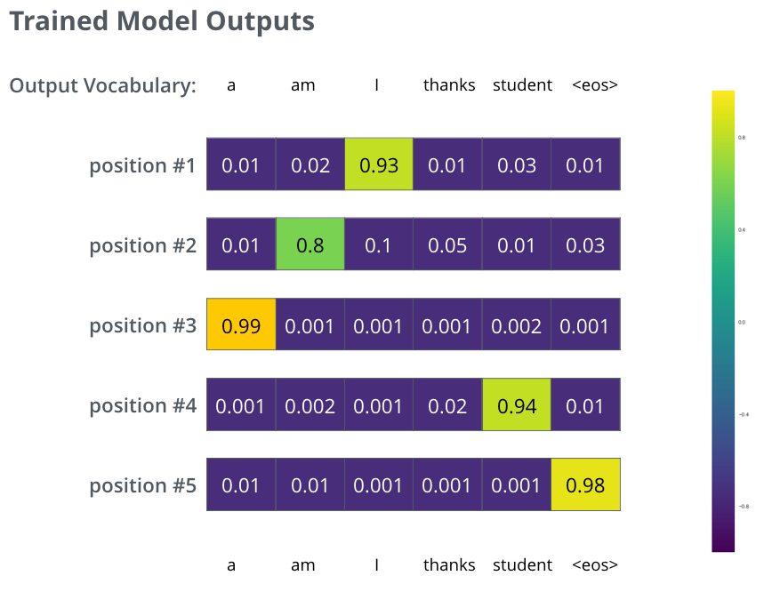

Slide 63
Results

Slide 64
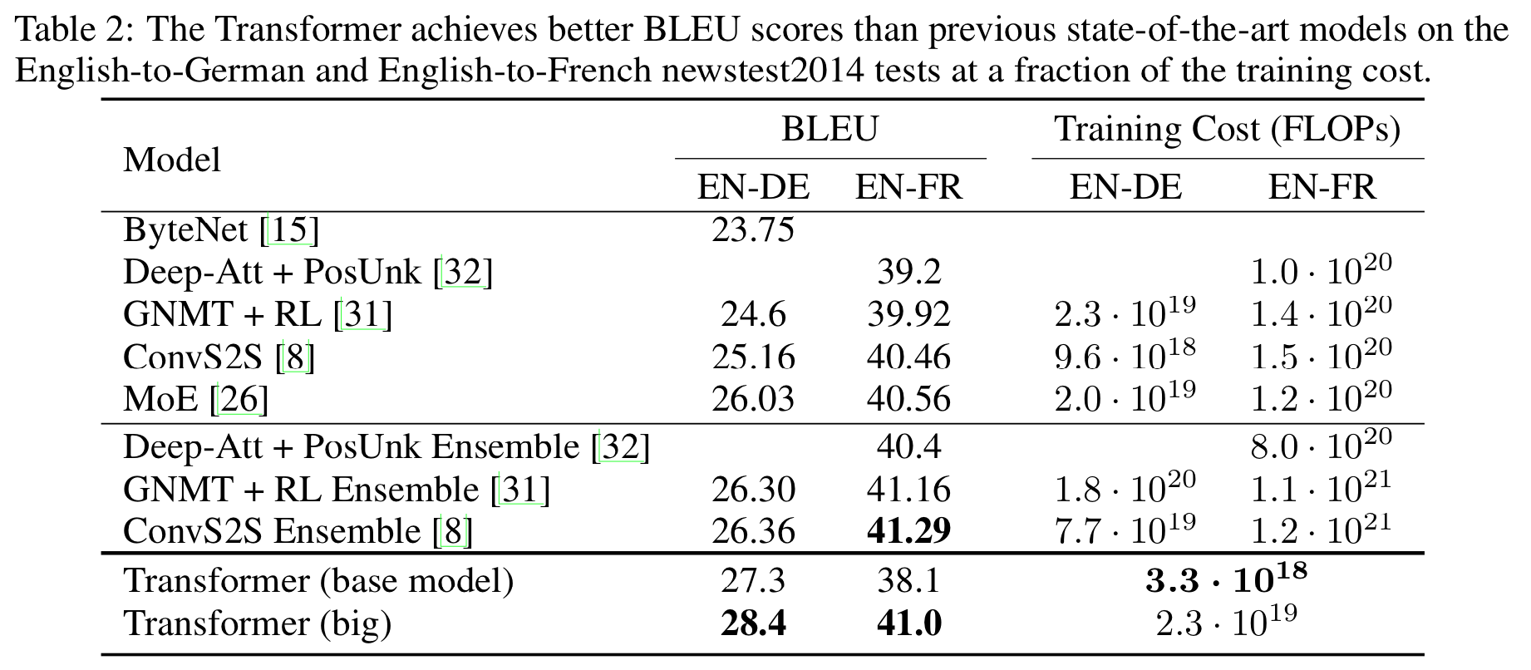
Trained 3 times longer than the base model

Slide 65
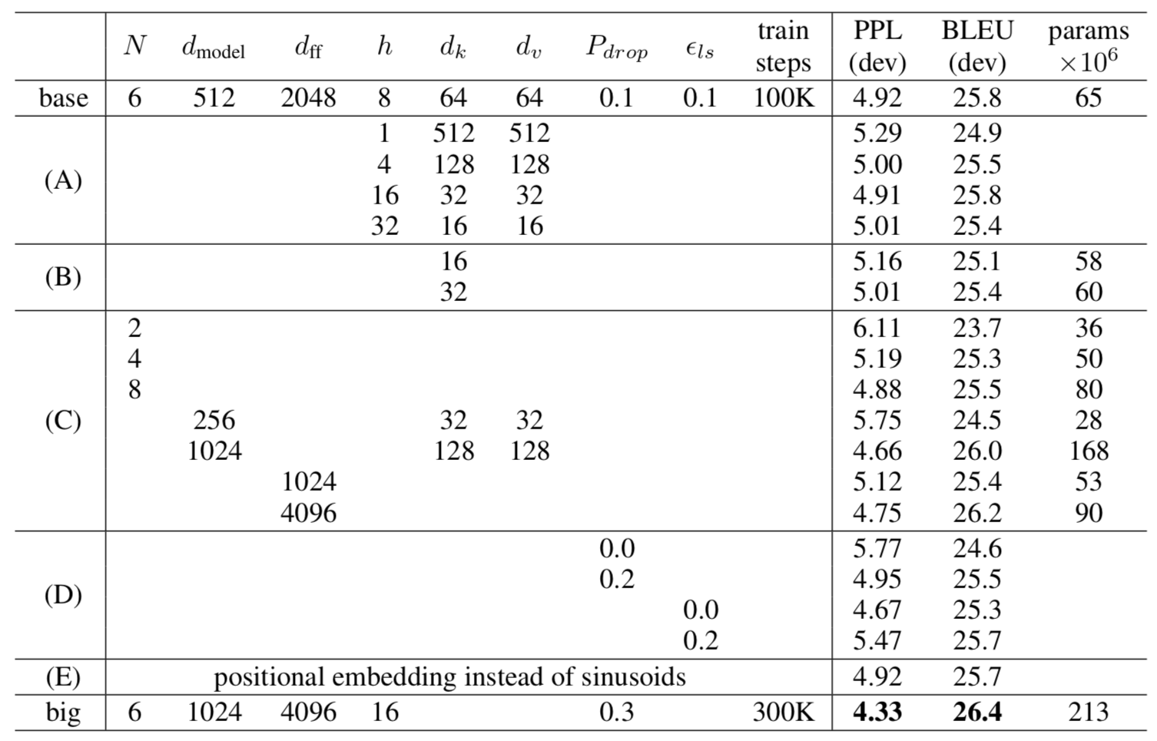
Reasonably stable performance

Slide 66
Stacking helps

Slide 67
More than 1 head (h) helps, but not too many

